Slide 1
Business Case Study

Slide 2
Tables to be Downloaded
Customers
Suppliers
Employees
Products
Shippers
Orders
Order_Details

Slide 3
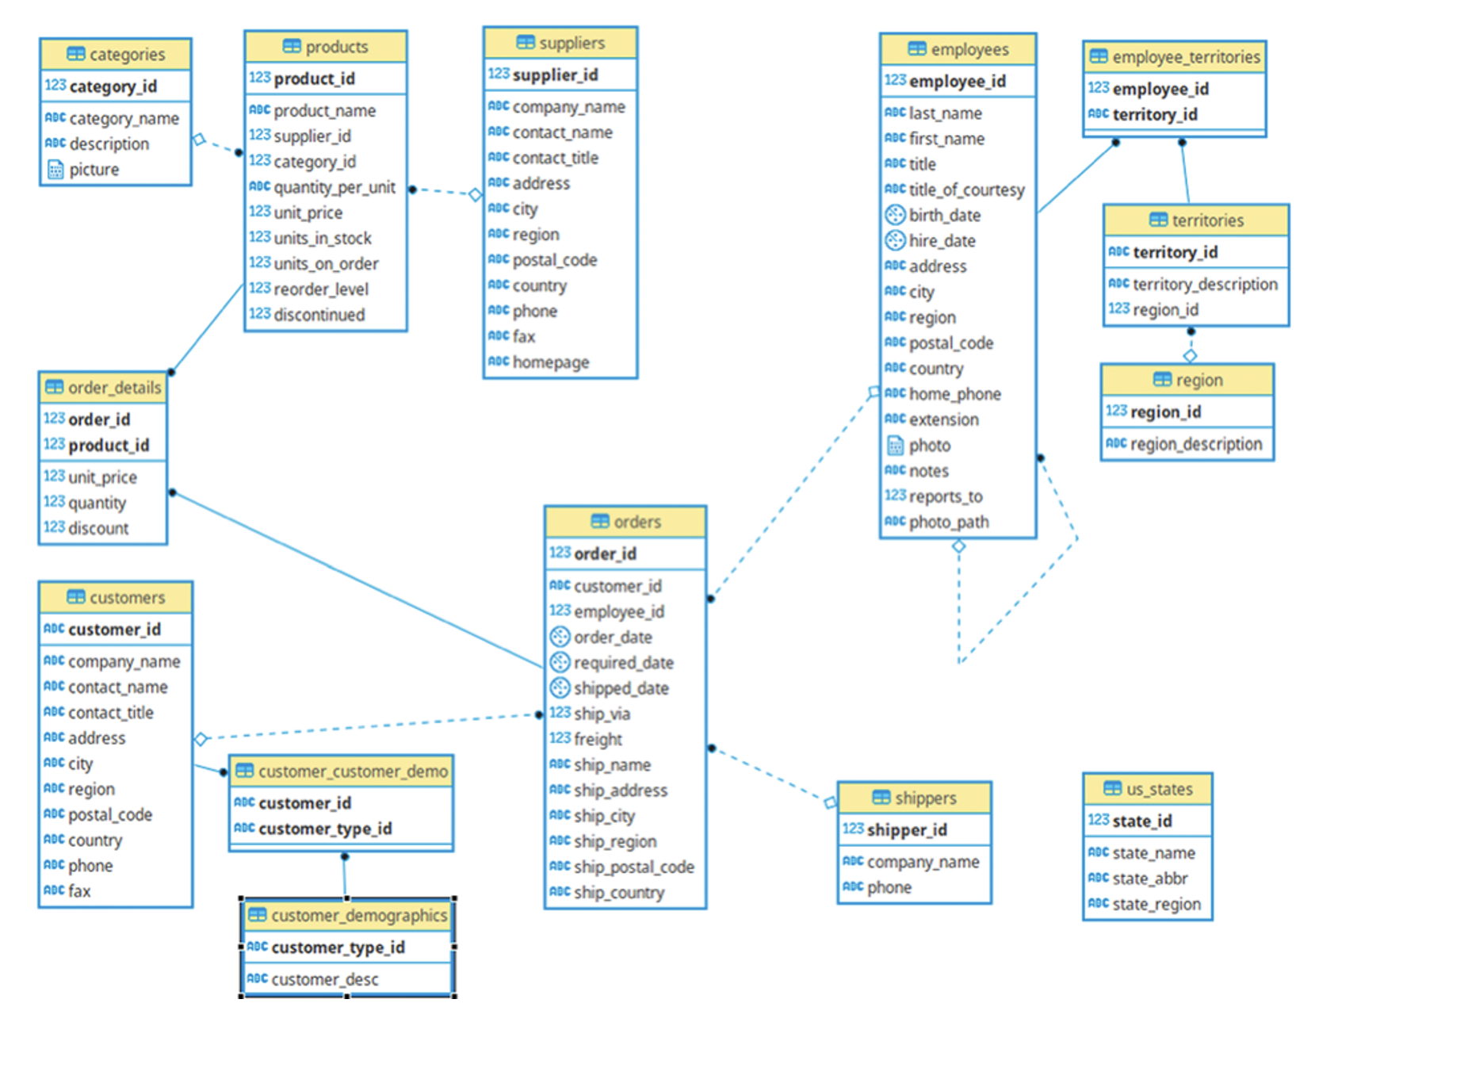
Schema

Slide 4
Ques1. Fetch the full name and hiring date of all Employees who work as Sales Representatives.
select concat(firstname, " ", lastname) as fullname,hiredate
from `ShippingCasestudy.employees`
where title = "Sales Representative";

Slide 5
*Ques2. Which of the products in our inventory need to be reordered?
select productid, productname , unitsinstock, reorderlevel
from `ShippingCasestudy.products`
where unitsinstock <=reorderlevel
order by productid;

Slide 6
*Ques3. Find and display the details of customers who have placed more than 5 orders.
SELECT c.customerid
FROM `ShippingCasestudy.customers` AS c
INNER JOIN `ShippingCasestudy.orders` AS od
ON c.customerid = od.customerid
GROUP BY c.customerid
HAVING COUNT(od.orderid) >= 5;

Slide 7
*Ques4. An employee of ours (Margaret Peacock, EmployeeID 4) has the record of completing most orders. However, there are some customers who've never placed an order with her. Show such customers.
SELECT c.customerid,od.customerid
FROM `ShippingCasestudy.customers` AS c
left join `ShippingCasestudy.orders` AS od
ON c.customerid = od.customerid and od.employeeid = 4
WHERE od.customerid is null;

Slide 8
*Ques5. The developers at Cochin Traders are testing an app that the customers will use to show orders. In order to make sure that even the largest orders will show up correctly on the app, they'd like some samples of orders that have lots of individual line items. Display the top
10 orders with the most line items.
select customerid, count(orderid) as mostLineItems
from `ShippingCasestudy.customers`
inner join `ShippingCasestudy.orders`
using(customerid)
inner join `ShippingCasestudy.orders_details`
using(orderid)
group by customerid
order by mostLineItems DESC
LIMIT 10;

Slide 9
*Ques6. Retrieve the top 5 best-selling products on the basis of the quantity ordered.
SELECT productname,
SUM(quantity) as totalQuantity
from `ShippingCasestudy.orders_details`
inner join `ShippingCasestudy.products`
using(productid)
group by productname
order by totalQuantity desc
LIMIT 5;

Slide 10
*Ques7. Analyze the monthly order count for the year 1997.
select
EXTRACT(MONTH FROM orderdate) as month,
COUNT(*) as ordercount
from `ShippingCasestudy.orders`
where EXTRACT(YEAR FROM orderdate) = 1997
group by month
order by month;

Slide 11
*Ques8. Calculate the difference in sales revenue for each month compared to the previous month.
WITH month_revenue AS
(
select
FORMAT_DATE('%Y-%m',orderdate) as monthdatayearwise,
ROUND(SUM(quantity * unitprice),2) as revenue
from `business_case_study.orders` o
INNER join `business_case_study.orders_details` od
ON o.orderid = od.orderid
group by monthdatayearwise
)
SELECT monthdatayearwise,revenue,
LAG(revenue) OVER(order by monthdatayearwise) as previousMnthrevenue,
ROUND(revenue - LAG(revenue) OVER(order by monthdatayearwise),2) as revenue_diff,
from month_revenue
order by monthdatayearwise;

Slide 12
*Ques9. Calculate the percentage of total sales revenue for each product.
select productid,
productname,
ROUND((SUM(od.quantity * od.unitprice) / (SELECT SUM(quantity *unitprice) FROM `ShippingCasestudy.orders_details`)),2) * 100 AS Percentage
from `ShippingCasestudy.products` p
inner join `ShippingCasestudy.orders_details` od
using(productid)
group by productid, productname
order by percentage desc, productid, productname;

Slide 13
*Ques10. Determine the cumulative percentage of total sales revenue for each month.
with cte as (
select
extract(year from orderdate) as year,
extract(month from orderdate) as month,
ROUND(SUM(unitprice* quantity),0) as sales,
from `ShippingCasestudy.orders`
inner join `ShippingCasestudy.orders_details`
using(orderid)
group by year, month
)
select year,month ,
ROUND(SUM(sales) over(order by year, month)/sales*100,0) as cummulativesales
from cte
order by year,month;

